Slide 1
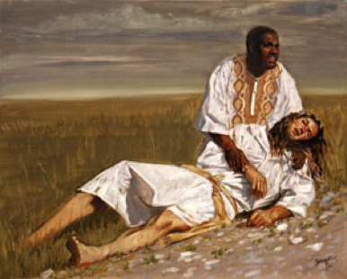
“A man was going down from Jerusalem to Jericho, when he was attacked by robbers. They stripped him of his clothes, beat him and went away, leaving him half dead. A priest happened to be going down the same road, and when he saw the man, he passed by on the other side. ³So too, a Levite, when he came to the place and saw him, passed by on the other side. But a Samaritan, as he traveled, came where the man was; and when he saw him, he took pity on him. He went to him and bandaged his wounds, pouring on oil and wine. Then he put the man on his own donkey, brought him to an inn and took care of him. The next day he took out two denarii and gave them to the innkeeper. ‘Look after him,’ he said, ‘and when I return, I will reimburse you for any extra expense you may have.’ (Lk 10:30-35)

Slide 2
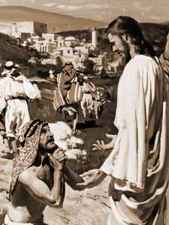
“And it came to pass, as He went to Jerusalem, that He passed through the midst of Samaria and Galilee. And as He entered into a certain village, there met him ten men that were lepers, which stood afar off: And they lifted up their voices, and said, ‘Jesus, Master, have mercy on us.’ And when He saw them, He said unto them, ‘Go show yourselves unto the priests.’ And it came to pass, that, as they went, they were cleansed. And one of them, when he saw that he was healed, turned back, and with a loud voice glorified God and fell down on his face at His feet, giving him thanks: and he was a Samaritan. And Jesus answering said, ‘Were there not ten cleansed? but where are the nine?’ There are not found that returned to give glory to God, save this stranger?’And He said to him, ‘Arise, go thy way: your faith hath made you whole.’ (Lk 17:11-19)

Slide 3
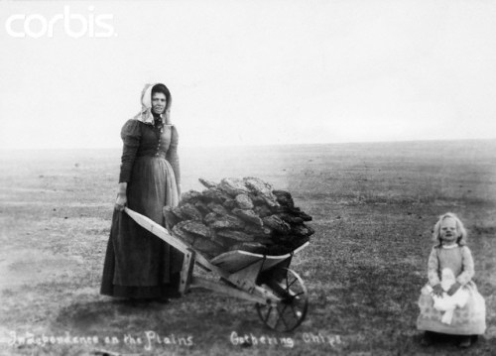
Be Grateful for this!

Slide 4
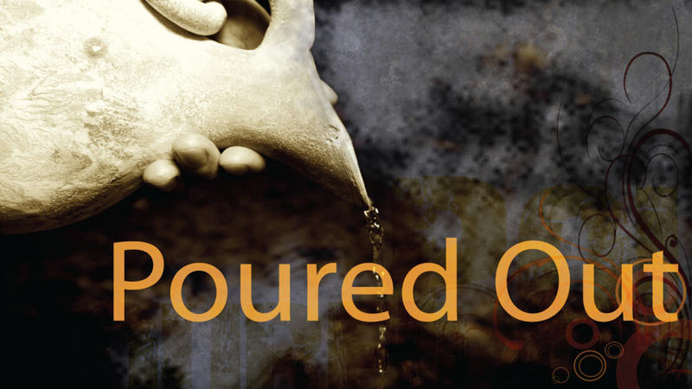
A ‘thank offering’ was poured out in full view and hearing of the entire congregation for:
Deliverance from distress, death or sickness Ps 50:23 Ps 107:21-22 Ps 56:12-13
Following a vow to God in anticipation of an answer to prayer Ps 7:17 Ps 66:13-14
At times of religious renewal 2Ch 29:31 2Ch 33:15-16 Jer 17:26; Jer 33:11

Slide 5
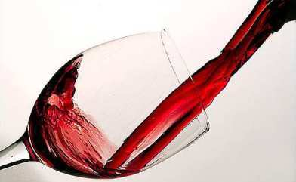
“For I am already being poured out as a drink offering, and the time of my departure is at hand.” (II Tim 4:6)

