Slide 2
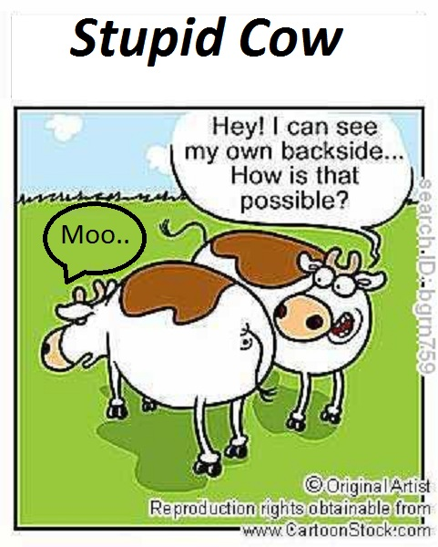

Slide 3
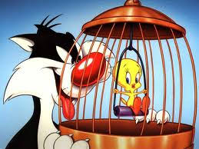

Slide 5
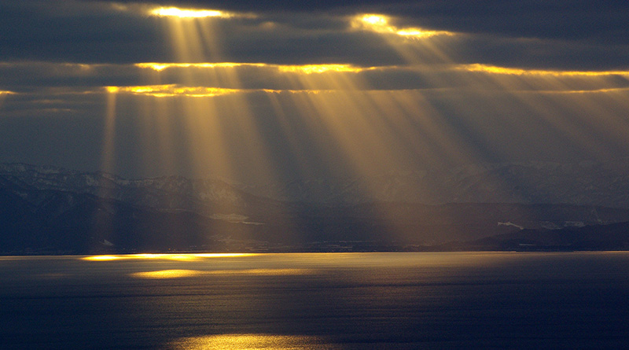
Without hesitation he said, “Heaven!”

Slide 6
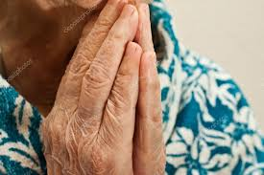
Those dear, crinkly hands became so precious to me and gorgeous!

Slide 7
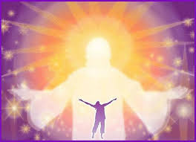
2 Corinthians 3:18
“And we all, who with unveiled faces contemplate the Lord's glory, are being transformed into His image with ever-increasing glory, which comes from the Lord, who is the Spirit.”

