Slide 4
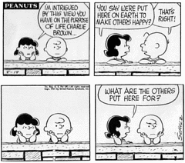

Slide 5
First In Body Corporate there is no discrimination.
Second In Body Corporate there is elevation.
Third In Body Corporate none are exempt from edification.
This comes about in two ways:
By praise of Contribution.
By heartful Confrontation.
Fourth In Body Corporate there is no schism.
Fifth In Body Corporate there is no hoarding.

Slide 6
We have meaning and purpose. We have each other. We are in this grand life to give light and hope to the walking dead! We are to tend for each other and accept our strengths and improve on our infirmities!

