Slide 2
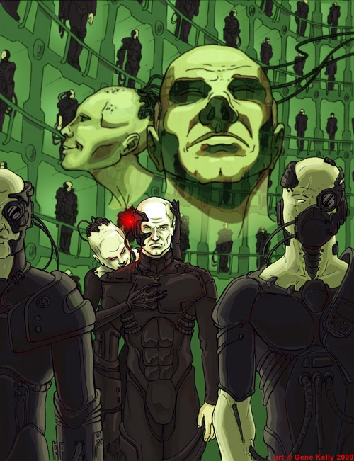
Resistance is Futile! You Will be Absorbed

Slide 3
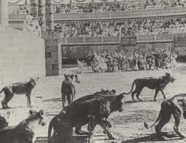
These wretched souls ‘would not stop their singing as one voice.’ Their faces on the death agony, ‘all were smiling’ as they
grouped together for courage and prayers to the God they were about to meet.

Slide 4
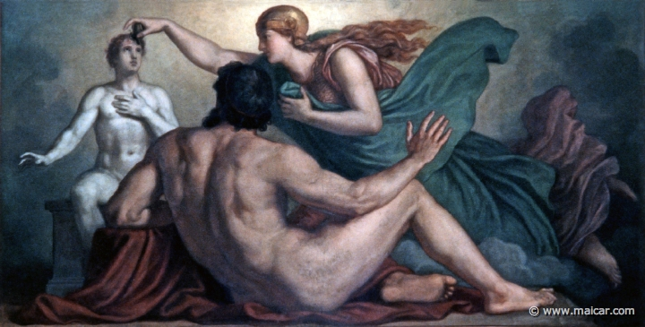
“Let Us make a man in Our Image, according to Our likeness.”
Genesis 1:26a

Slide 5
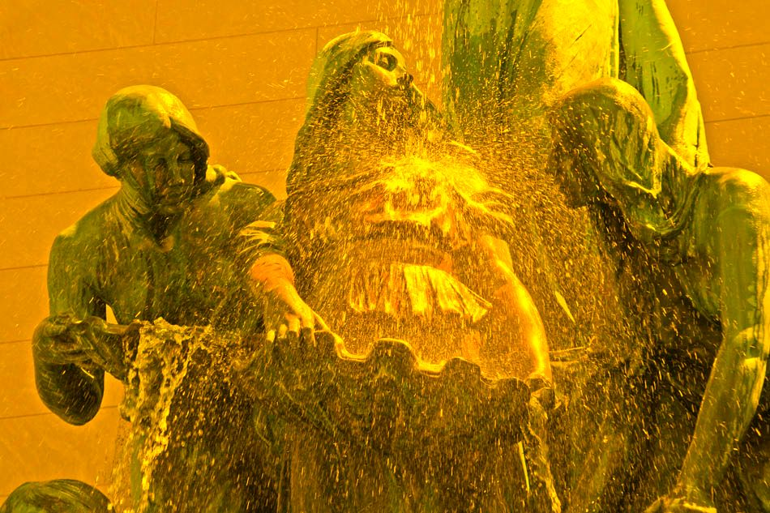
The Christ emptied Himself out of this form and took upon the flesh of mankind

Slide 6
This is why God cloned an infant of Heavens’ Caliber into the maiden Mary, formed from a new ground and nourished by a higher-ordered umbilical cord, untainted by Adam’s sin and without a destiny of eternal separation from His True Father of Lights.

Slide 7
