Slide 2
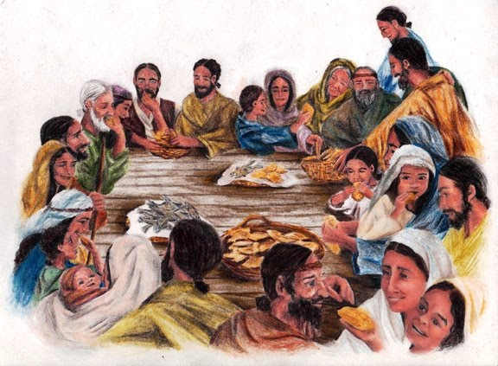
“So continuing daily with one accord in the temple, and breaking bread from house to house, they ate their food with gladness and simplicity of heart, praising God and having favor with all the people. And the Lord added to the church daily those who were being saved.”
Acts 2:46-47

Slide 3
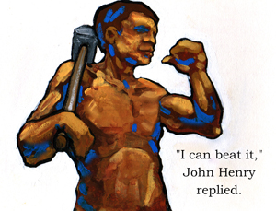
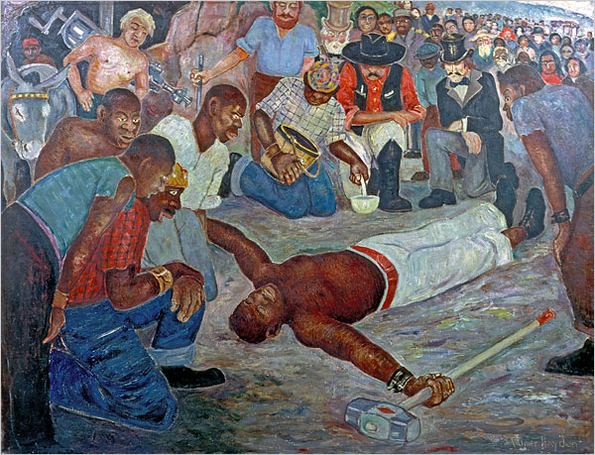
He won, but his heart gave out and he died moments after the clock turned. And steam did take over the work, which of course, has given way to even better technology.

Slide 4
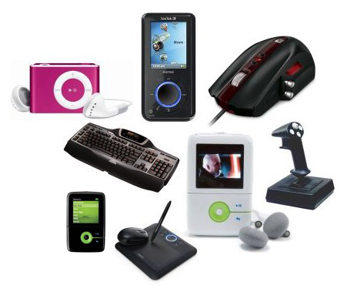
With the advent of the social media instruments, short wave, z-band and satellite; I highly doubt there is a single, habitable populace that hasn’t heard at least
John 3:16
It is so very, very easy to lead souls to the savior in our on-line connections today!

Slide 5
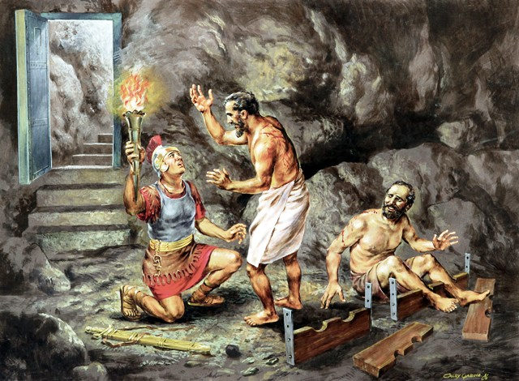
WHAT MUST I DO TO BE SAVED?

Slide 6
“Just how was this unnamed, remaining Chinese believer?

Slide 7
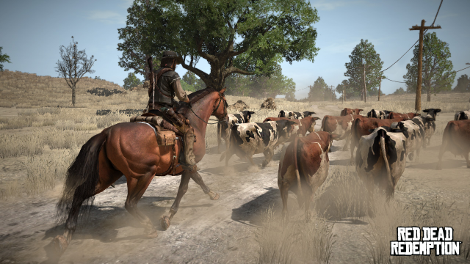
And all around Us is everyday, rather ordinary humanity, who are being herded like cattle by a malicious, weathered and gnarly cowboy bent on slaughtering them, sending them all screaming into a crowded holding arena, to await a fate far worse than the dying.

