Slide 1
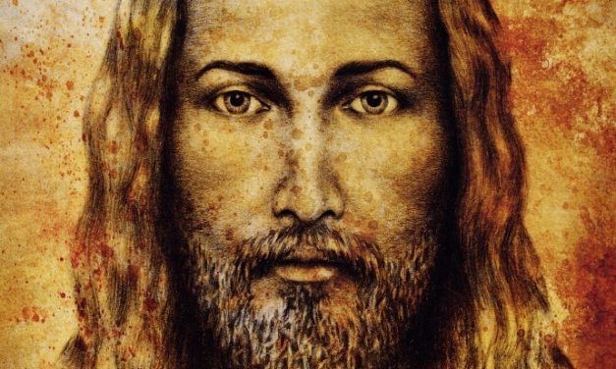
Hebrews 11:1
“Now faith is the substance of things hoped for, the evidence of things not seen.”
Here are a few facts.
He lived, did miracles, was crucified, and His Body was never found. At least 500 witnesses and other disciples testified to His resurrection. Our faith is in vain if we waffle on these truths.

Slide 2
Who created them?
Job 38:4-7

Slide 3
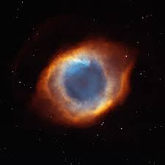
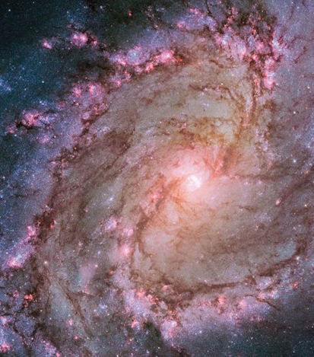
All life, in all the universes that Hubble,
professors, savants, astrophysicists and
astronomers have discovered only prove
the intelligent design of a creator

Slide 5
The faith has endured for millenniums, the One God remains enthroned. No murder, onslaught of mockery, spitting spit, torture or Intellectual manipulation, bribery, massacre or demonic schemes have overthrown US! Our flame and fury in the darkness rages on and on and on! Nothing can quench the Cross!
This is proof enough

