Slide 2
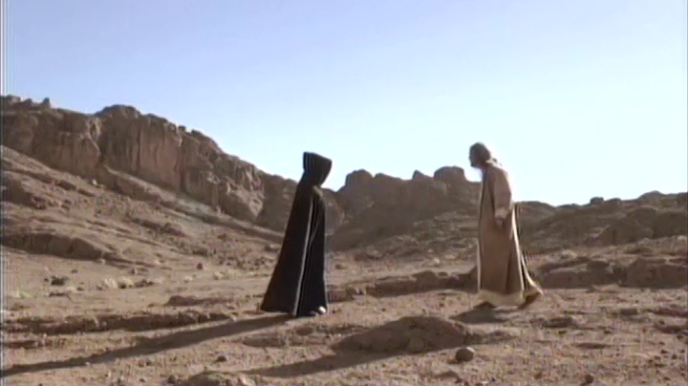
Jesus said to him, “Away from me, Satan! For it is written: ‘Worship the Lord your God, and serve him only.’ Then the devil left him, and angels came and attended him.
Matthew 4:10-11

Slide 3
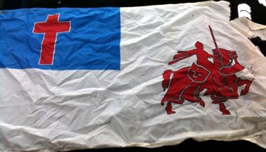
‘I pledge allegiance to the Christian flag and to the Savior for whose Kingdom it stands, one brotherhood uniting all Christians in service and love.’

Slide 4
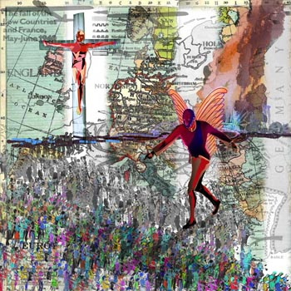
Now, I’m not advocating ‘sympathy for the devil’ but rather a certain caution that denotes a wide berth.

Slide 6
LIFE LESSONS
One: An “It” does not watch me.
Two: Jesus doesn’t do ‘presto/abracadabra stuff.’
Three: Face problems head on.
Four: Be wary of what’s in walls!
Tools to use against the wiles of the Evil One.
One: Contain Your Thoughts!
Two: Never Be Ashamed!
Three: Make Your Confession to God Alone!
Four: Abstain From All Forms of Evil!
Five: Overcome Evil with Goodness!

