Slide 1
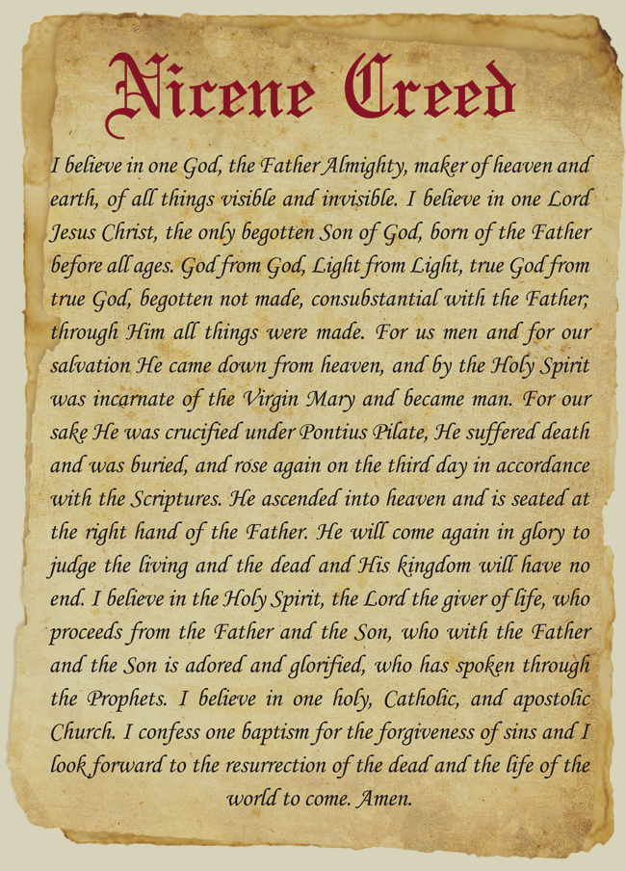

Slide 2
THE TRINITY

Slide 3
The Creation of the Universes by and thru Jesus Christ

Slide 4
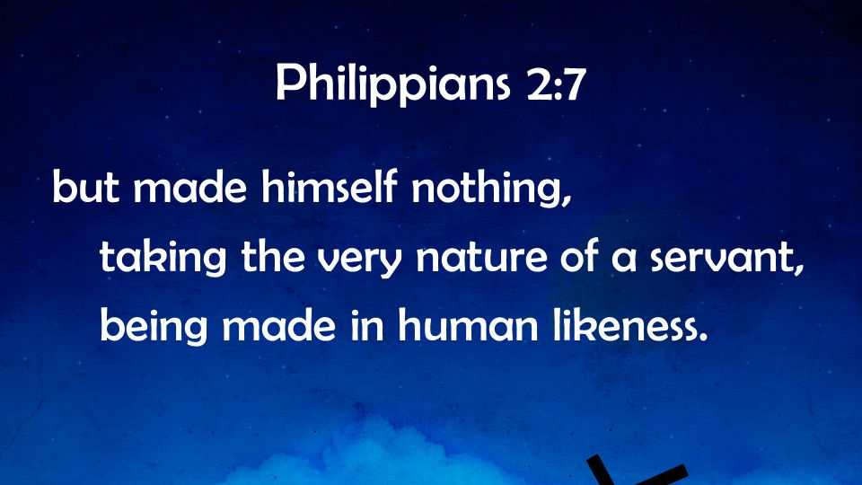
His Divine Origin and Human Birth

Slide 5
His Death, Burial and Resurrection
1 Corinthians 15:6

Slide 6
His Eventual Return

Slide 7
The Holy Spirit as Entity

Slide 8
The One Baptism for Forgiveness of Sins

Slide 9
The Coming New World

Slide 10
SO WE MAY NEVER GO DARK

