Slide 2
“I am the Alpha and the Omega, the First and the Last, the Beginning and the End.”
Revelations 22:13

Slide 3
What is between is truly between you and whatever winds of fate that blows!

Slide 4
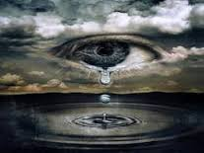
“Then the LORD saw that the wickedness of man was great on the earth, and that every intent of the thoughts of his heart was only evil continually. The LORD was sorry that He had made man on the earth, and He was grieved in His heart.”
Genesis 6:5

