Slide 2
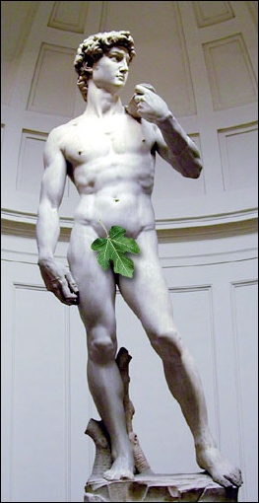
In every block of marble I see a statue
as plain as though it stood before me,
shaped and perfect in attitude and action.
I have only to hew away the rough walls that imprison the lovely apparition to reveal it to the other eyes as mine see it.
Michelangelo

Slide 3
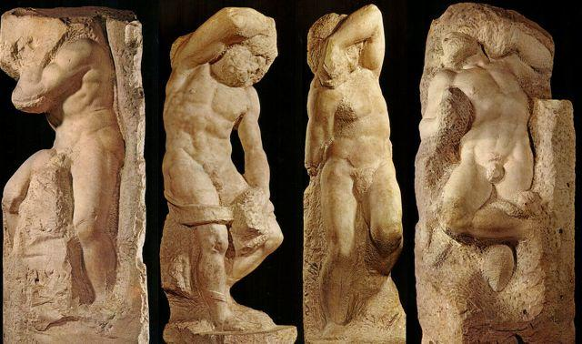
Behold!
The tragic power of these Prisoners as they struggle to emerge out of raw stone is
an expression of the human condition to emerge out of the bondage of toil and travail.
Michelangelo

Slide 4
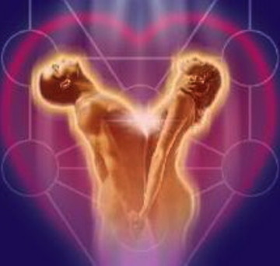
“And the Lord God formed man of the dust of the ground, and breathed into his nostrils the breath of Life: and man became a living soul.” (Genesis 2:7)
“And the Lord God caused a deep sleep to fall on Adam, and he slept; and He took out from his side and closed up the flesh in the place of the wound. Then from this organ which the Lord God had taken from man He handcrafted a woman, and He brought her to the man.” (Genesis 2:21-22)

Slide 5
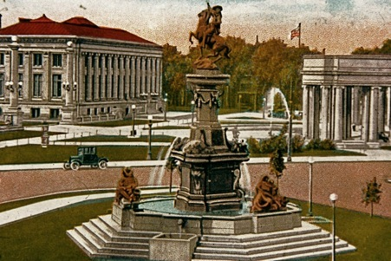
Pioneer Monument-Denver, CO

Slide 6
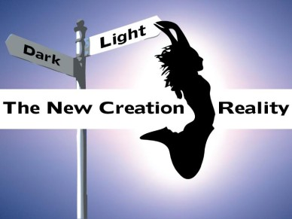

Slide 7
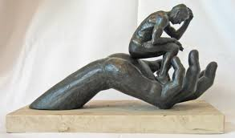
Look at His creation Through His Eyes: This is what God said to one of his prophets (I Samuel 16:7b)
“For the Lord sees not as man sees: man looks on the outward appearance, but the Lord looks on the heart.”
Don’t Cut the Beauty Out, but Expose It Only
Awake in the Morning with Fresh Perspective: (Colossians 3:1) proclaims
“Since then you have been raised with Christ, seek the things that are above, where Christ is,
seated at the right hand of God.”
Breathe and Be Warm
Let the Spirit Create In You:
This is what (Genesis 1:27) says.
“So God created mankind in His own image, in the image of God He created him; male and female He created them.”

