Slide 2
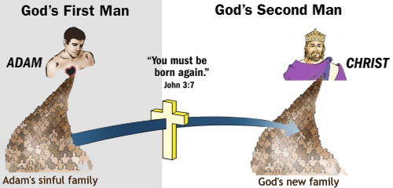

Slide 3
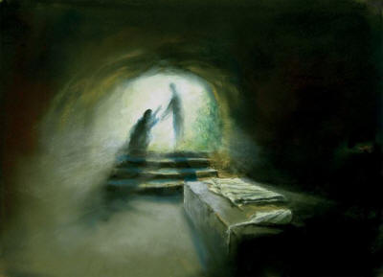
DEATH? NOT AVAILABLE!
Once a person ‘takes on Jesus’ as a personal Lord and Savior and makes that good confession, our entire D.N.A is changed to “Death Not Available!” Our redeemed souls no longer are burdened with a body meant for Hades, but rather to a mighty release in glory. (Col 1:13) states, “For He rescued us from the domain of darkness, and transferred us to the kingdom of His beloved Son.”

Slide 4
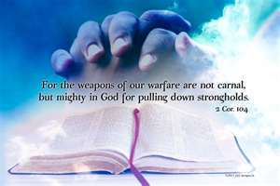
All believers are able to be “casting down imaginations, and every high thing that exalts itself against the knowledge of God, and bringing into captivity every thought to the obedience of Christ.” Because of Christ, His children are able to recoil and come back from evil habits and the shameful things ‘done in darkness.’

Slide 5
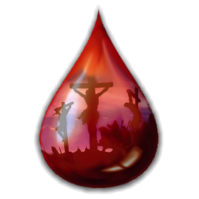
The shed blood of the Lamb is our ‘drug or choice’ and it is powerful indeed!

Slide 6
God charges Us in this positive addiction:
To Live in Light:
To Follow Spiritual Counsel:
To Go regularly to The Word:
Attend the Fellowship of the Saints:

Slide 7
We must take our knowledge of this positive addiction to application.
As to the ministry of the saints, one must be on-all 24 seven, 365!
One must be sensitive to the prompting of the Holy Spirit.
Keep close one’s own ‘makings.’

Slide 8
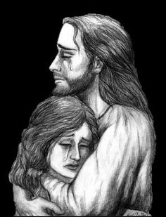
‘Get strung out’ on Jesus and His people!

