Slide 2
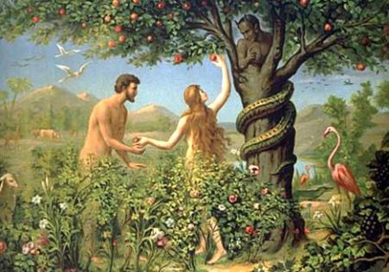
“And it was not Adam who was deceived, but the woman who was seduced and fell into transgression.”
(I Timothy 2:14)
Eve offered “to her husband the same who was with her, and he also partook.”
(Genesis 3:6c)

Slide 3
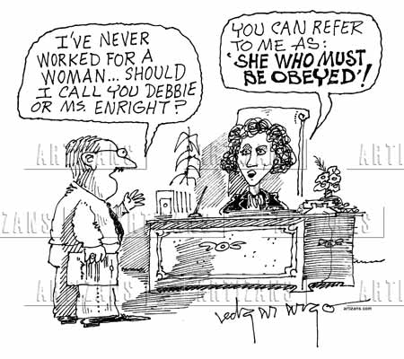

Slide 4
Science has made these determinations of females:
Biologically: It seems obvious. ‘Women have women parts.’
Phenomenology: Females perceive, sense and experience from conscientiousness other than male, with a tendency toward emotional drama and experiential sensate focus.
Sociologically: Girls enjoy math, sciences, philosophies, social work and shopping more than men.

Slide 5
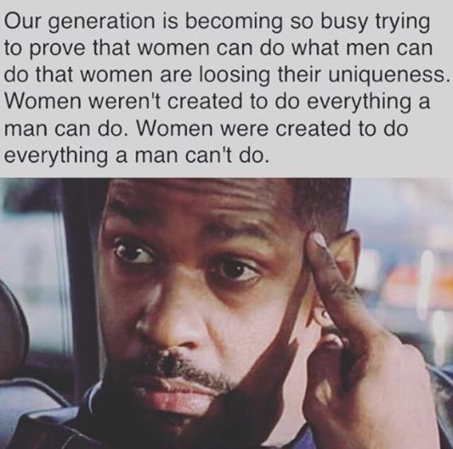

Slide 6
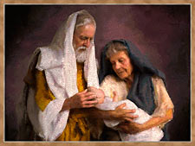
“After I am worn out, and my lord is old, shall I have pleasure?”

