Slide 3
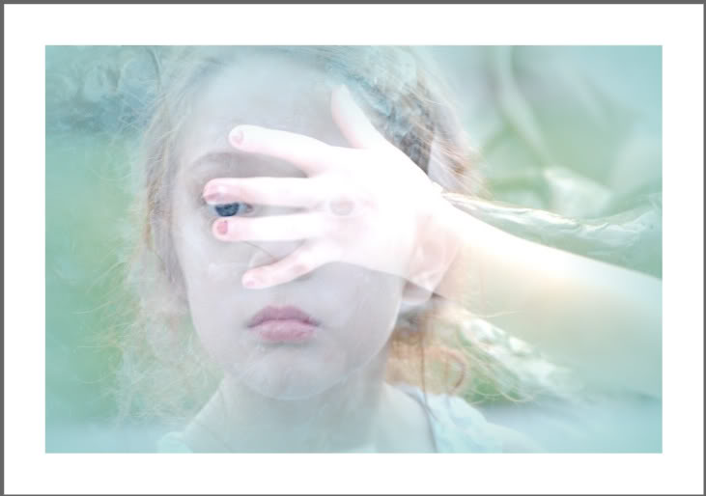
Your eye is a lamp that provides light for your body. When your eye is good, your whole body is filled with light. But if your eye be evil, your whole body shall be full of darkness. If therefore the light that is in you be darkness, how great is that darkness.
Matthew 6:22-33

Slide 4
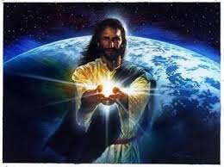

Slide 6
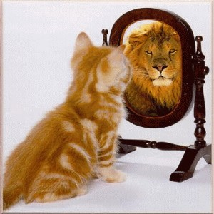
“Now we see but a poor reflection as in a mirror; then we shall see face to face. Now I know in part; then I shall know fully, even as I am fully known.”
I Corinthians 13:12

Slide 7
Let me tell you a few things God sees in you and me. God sees the:
Face of Jesus
Heartbeat of Community
Willingness to Serve
Loyalty to the Faith
Holy Emotions
Evangelistic Fervor

