Slide 2
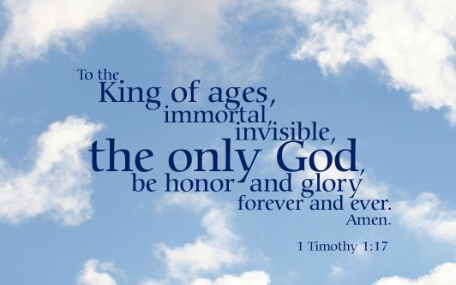

Slide 3
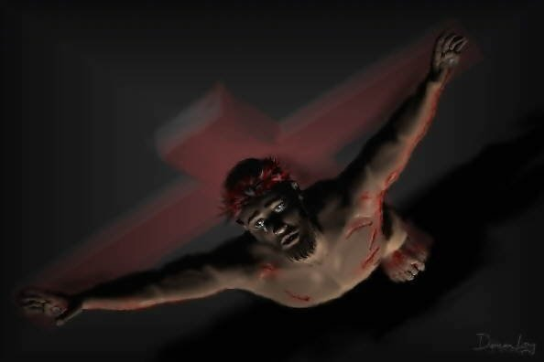
“And I, when I am lifted up from the earth, will draw all people to myself.”
John 12:32

Slide 4
There are three conditions of mankind that
Prevent
Hinder
or
Dismiss
Spiritual conversion and comprehension.
These are:
The Stratagems of the Fallen Archangel
Trauma Drama
Secular Philosophy

Slide 5
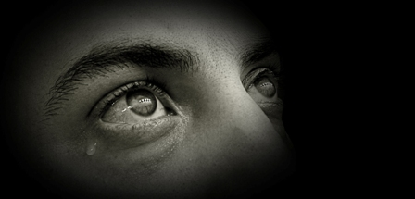
Now there are also three contraries to consider when developing one’s spiritual eyes.
What things pass, what things
remain? And now these three
remain: faith, hope and love.
But the greatest of these is love.
I Corinthians 13:13
Note this: One cannot ‘see’ these things.

Slide 6
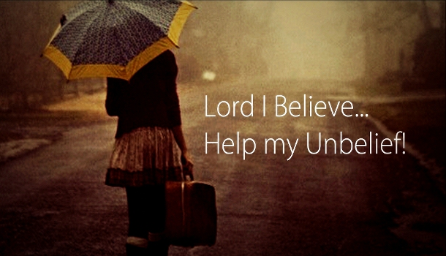
“And without faith it is impossible to please God”
Hebrews 11:6

Slide 7
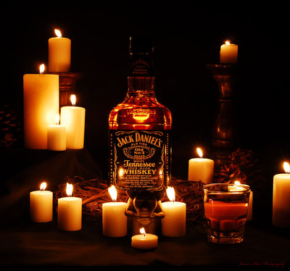
“Daddy, do you love me?”
He replied, rather coldly, “Of course.”
With tears in her eyes, she crawled into his lap and said, “I didn’t know for sure. Mommy said she thought you loved Jack Daniels more than me.

Slide 8
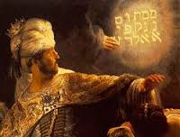
Mene; God hath numbered your kingdom, and finished it.
Tekel; you art weighed in the balances, and are found wanting.
Peres; Your kingdom is divided, and given to the Medes and Persians.

