Slide 2
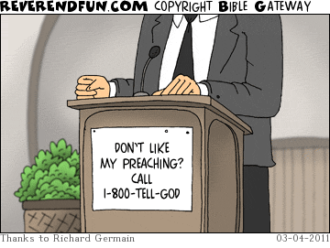
FYI

Slide 3
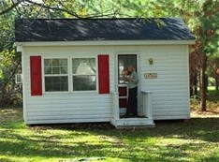
TINY HOUSE NATION

Slide 5
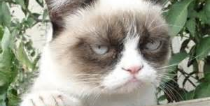
I’m not angry I’m happiness challenged!

Slide 6
Garbage In

Slide 7
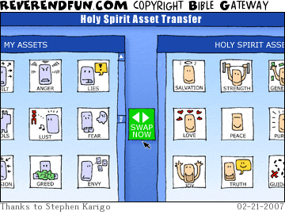
Fruit of the Spirit

Slide 8
Jesus In Me
I work 9-5 that’s my daily grind
At the end of my day this thought comes to mind,
Did they see Jesus in me?
Traffic annoyance, horn honking a lot!
“Friendly” gestures I’m making, happy I’m NOT!
No one sees Jesus in me!
Dinner & homework, everything in a rush
Got kids into bed, I’m enjoying the hush
Did my family see Jesus in me?
Into bed I collapse at the end of the day
Dreading tomorrow in my same old way
Feeling so desperate I finally pray,
“Help me Jesus, so everyone can see you in me!”

