Slide 2
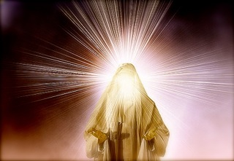
“When Moses came down from Mount Sinai with the two tablets of the covenant law in his hands, he was not aware that his face was radiant because he had spoken with the Lord. ”
^{(Exodus 34)}

Slide 3
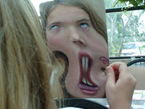
AFTER CHRIST!
BEFORE CHRIST!

Slide 4
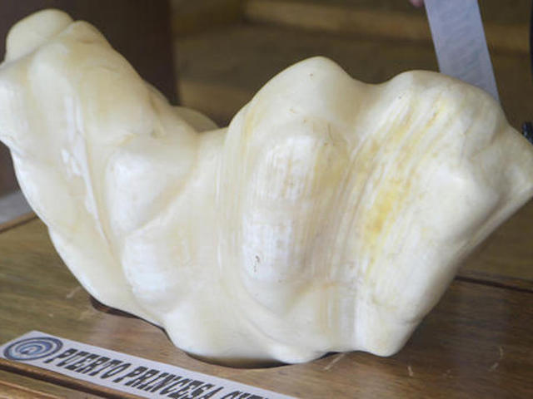
YEP! IT IS INDEED A PEARL!

Slide 7
Where Will You Be Placed?

