Slide 2
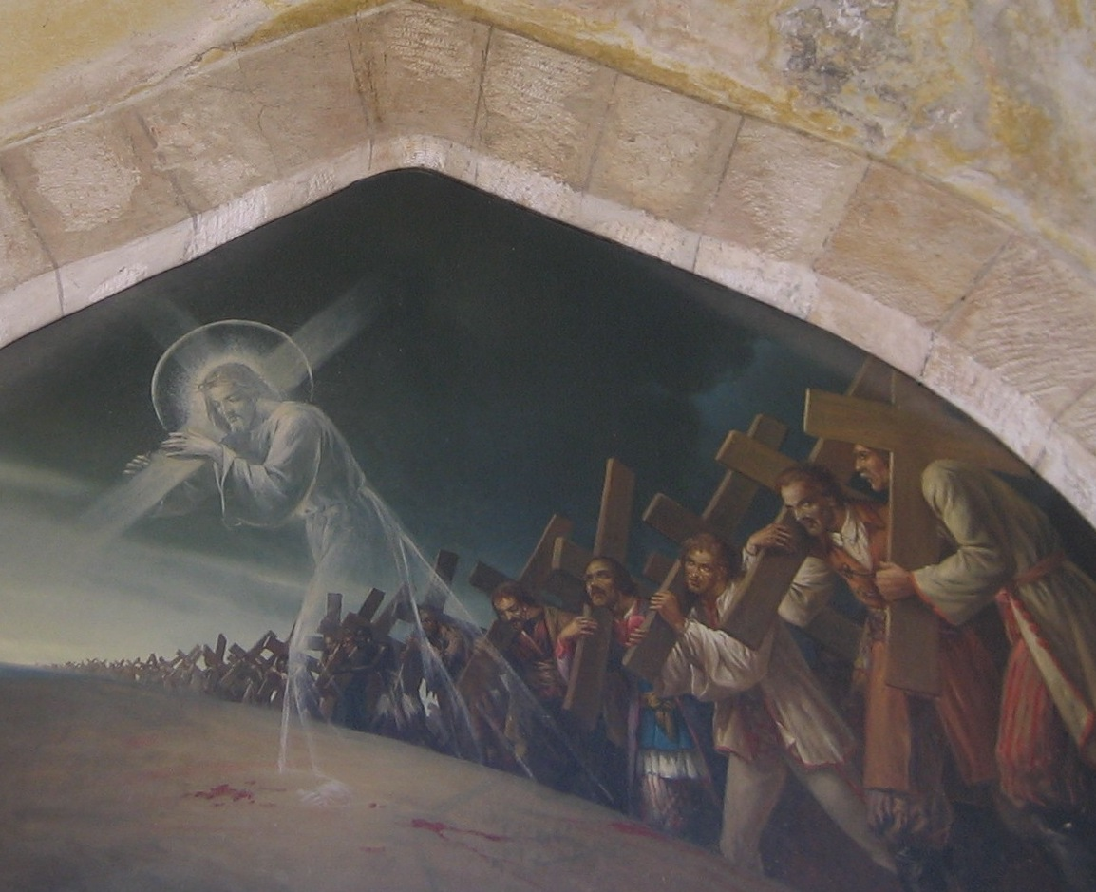

Slide 3
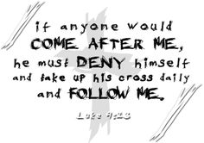

Slide 4
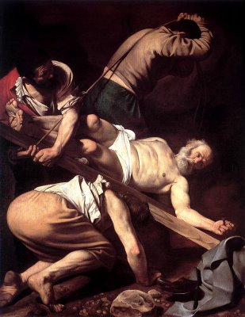

Slide 6
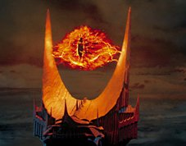
This righteous death freed Us from ‘the eye of the needle’ bondage to give up anything, pledge allegiance to, sale out everything or turn our backs on loved ones—in order to wear His brand or to become His disciples.

Slide 7
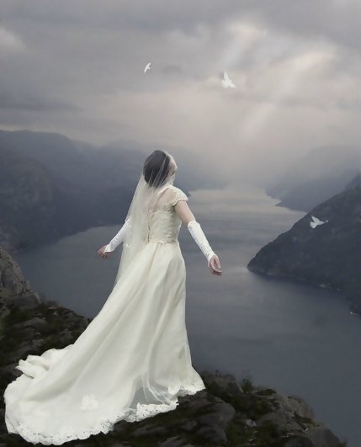
The fire of damnation has been eternally quenched for all believers!

