Slide 3
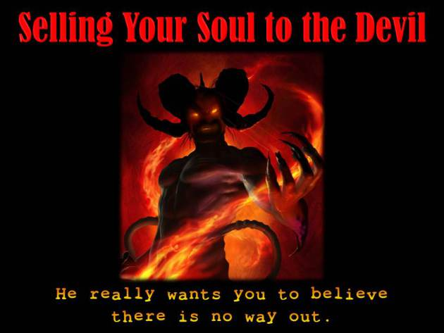

Slide 4
Two concepts are taught in our dispensation regarding the lifestyle expected of Grace:
Self-Control:
To the (Phillipians 4:5) church Paul penned
“Let your moderation be known unto all men. The Lord is at hand.”
Putting Away of Indulgence:
To the (Ephesians 4:12) church Paul ordered,
“That all put off concerning the former lifestyle the old man, which is corrupt according to the deceitful lusts.”

Slide 5
Four outcomes are the product of an authentic walk/talk in Grace. These are people that:
Listen to Spirit Communication
Submit to the Accountably
Share the Truth of Grace
Deepen in the Word

Slide 6
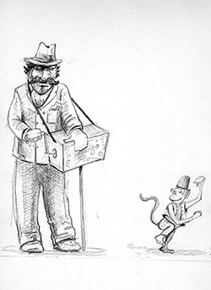
Before we became Saints, we were all like monkeys on a leash, doing a reel to the discordant sounds of the Evil Grinder of our souls.
We grimaced and begged for attention and took up a collection for our Master

