Slide 3
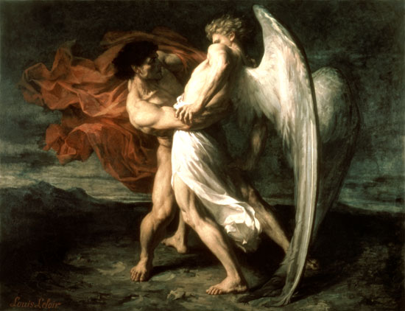
“I have seen God face to face and my life is preserved.”
Genesis 32:29-30

Slide 4
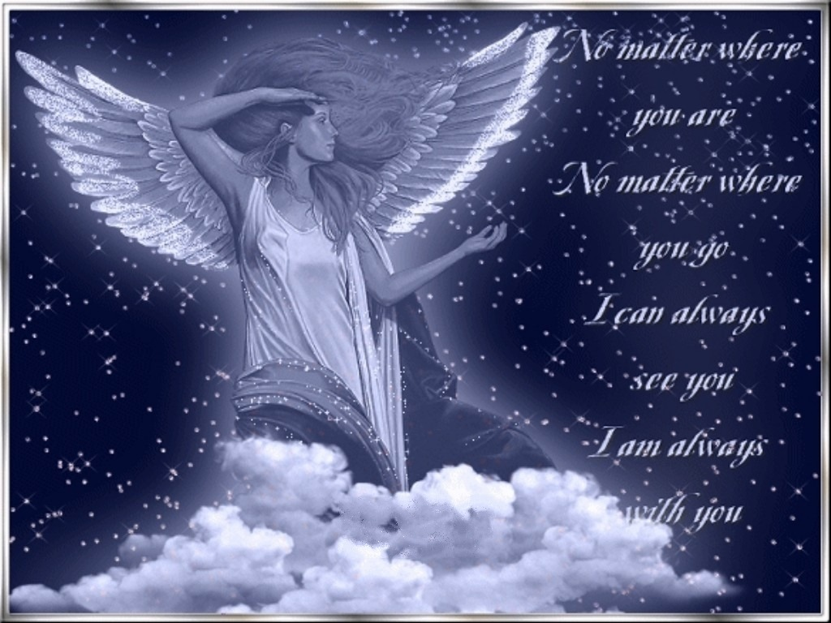

Slide 5
“Blessed by the God and Father of our Lord Jesus Christ, who has blessed Us with all spiritual blessings in the heavens in Christ.”
Ephesians 1:3

Slide 6
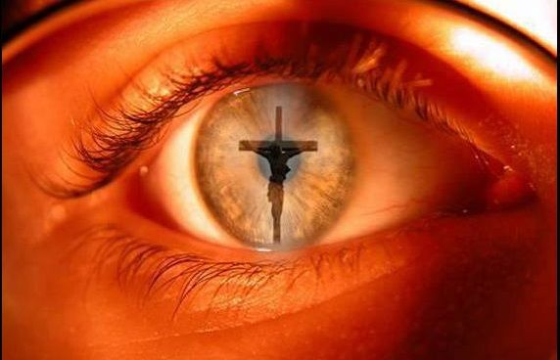
Looking unto Jesus, the author and finisher of our faith; who for the joy that was set before Him endured the cross, despising the shame, and is set down at the right hand of the throne of God. Hebrews 12:2

Slide 7
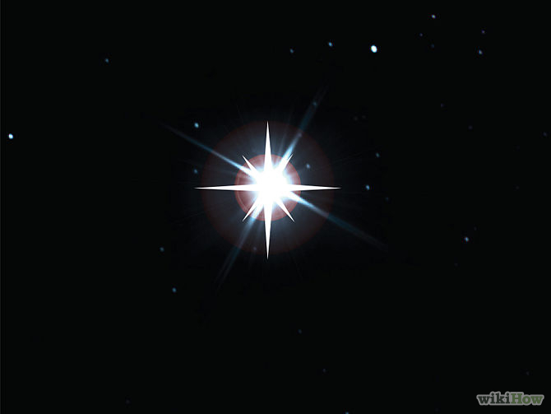
“We have also a more sure word of prophecy; whereunto you do will that you take heed as unto a light that shines in a dark place, until the day dawn, and the day star arise in your hearts.”
II Peter 2:19

Slide 8
This one thing I do, forgetting those things which are behind, and reaching forth unto those things which are before, I press toward the mark for the prize of the high calling of God in Christ Jesus.
Philippians 3:13-14

