Slide 1
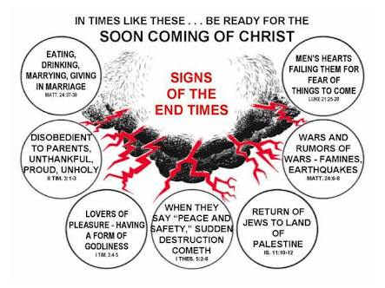

Slide 3
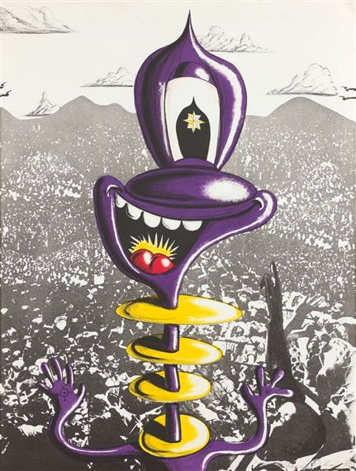
Deuteronomy 20:2b “You shall have no other gods before Me.”
Forget this commandment and reckoning comes.

Slide 4
In the manifestation of Unconstrained Evil.
In Rampant Entitlement and Intolerance. A Christian girl attended a world religion class in which one of the assignments was to present in written and oral form the religion of one’s faith beliefs. However, Christianity was disallowed. The professor said that it was too common and divisive for college freshmen. And though indignant, she filed no protest.
The belief that one is inherently deserving of privileges or special treatment is a myth, though highly regarded as truth.
Options and Distractions. I treat young people who have no achievable dreams, ambitions and with nothing of meaningful interest. They all share two things in common: Video games and wandering in the mind.
Isolation and Loneliness. The more devises we have to communicate the more divisive we’ve become.
Leadership Failure. This one floored me. Our pastors, clergy, religious teachers should be ashamed of the pablum spewed, touted as theology.

Slide 5
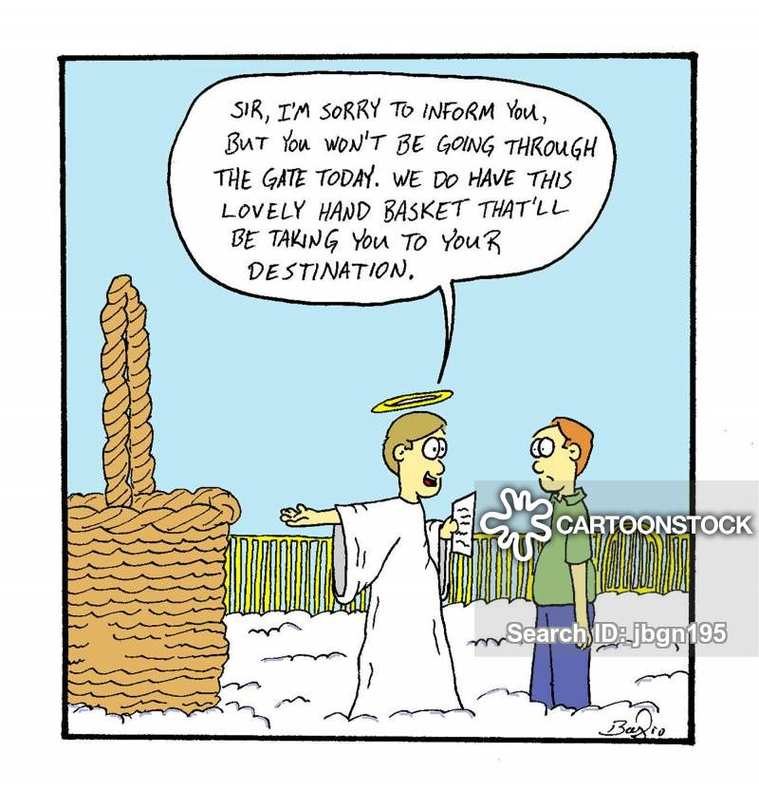
To pull back from Hell’s basket will take courage to do at least three things, which are:

Slide 6
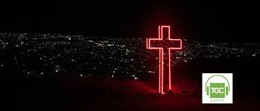
Confront the ungodly when opportunity comes.
Examine your life.
Run into the darkness.

Slide 7
(2 Corinthians 6:14)
“Don’t team up with those who are unbelievers.
How can righteousness be a partner with wickedness? How can light live with darkness?”

